Slide 1
Chapters 9 and 10
Commercial and soft rock, and punk and new wave

Slide 2
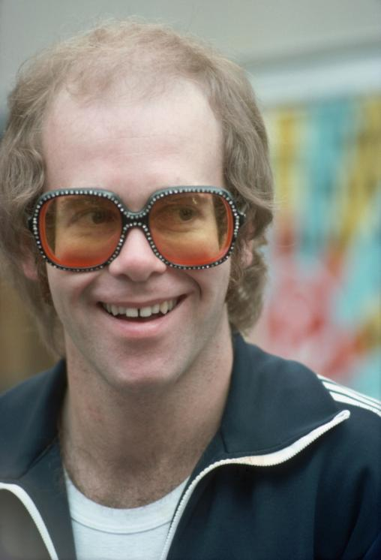
Commercial and soft rock
The late 1960s and early 1970s saw the rise of an introspective style collectively known as soft rock. Largely performed by singer-songwriters on guitar or piano, songs were highly crafted and generally contained more adult lyrics. Elton John (pictured right) personified the commercial soft rock sound.
Alamy/Trinity Mirror/Mirrorpix

Slide 3
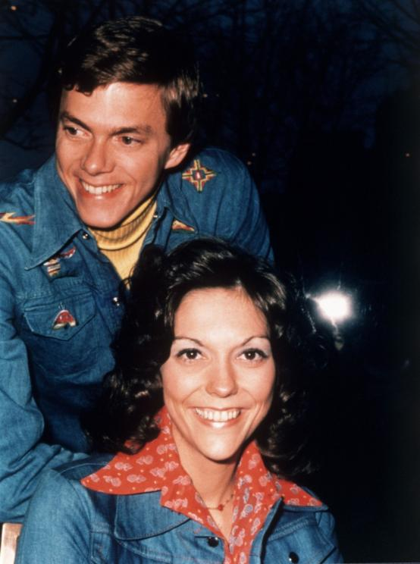
Close harmony vocals
Many soft rock songs featured close harmony vocals with lush backings. The brother and sister group the Carpenters (pictured right) excelled in this style.
Alamy/Pictorial Press Ltd

Slide 4
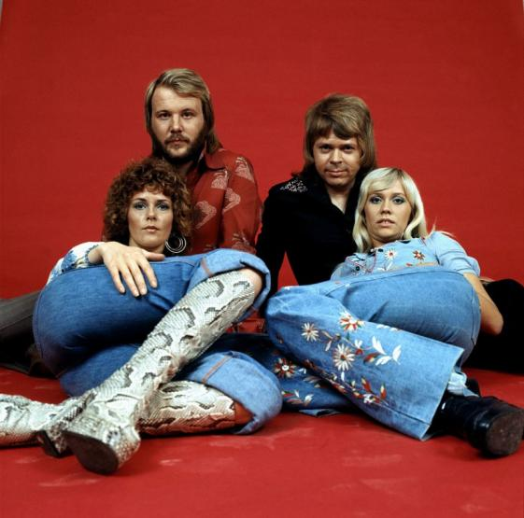
ABBA
Arguably the most successful soft rock group of the 1970s were the Swedish group ABBA(pictured right). Hugely popular in Australia, they produced hit after hit throughout the 1970s, including the critically acclaimed ‘Dancing Queen’.
Alamy/AF archive

Slide 5
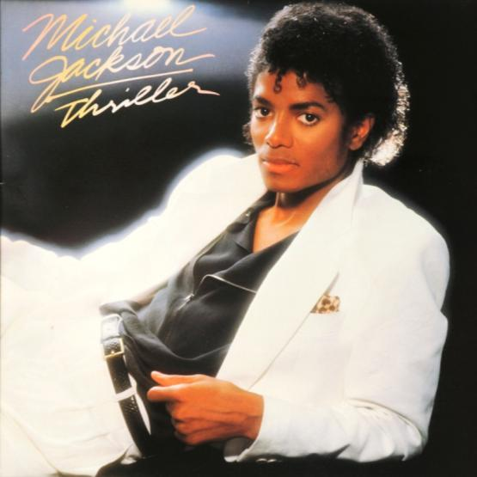
Michael Jackson
In the 1980s soft rock began to incorporate the disco beat and synthesised instruments. These came together in the most successful album of all time, ‘Thriller’, by Michael Jackson (pictured right). ‘Thriller’ is reputed to have saved the recording industry in the 1980s as record sales declined.
Alamy/CBW

Slide 6
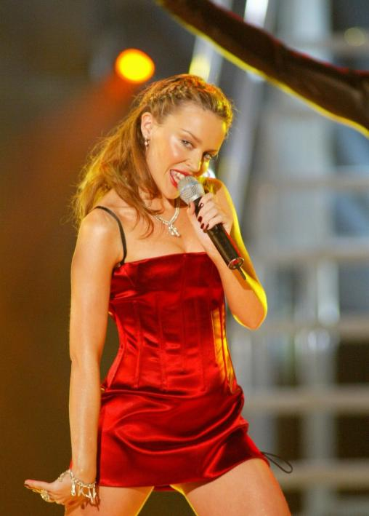
Kylie
An enduring Australian artist who captured the 1980s post-disco commercial sound was Kylie Minogue (pictured right). She has continued to release songs to critical acclaim for over 30 years.
Corbis/Stephane Cardinale/Sygma

Slide 7
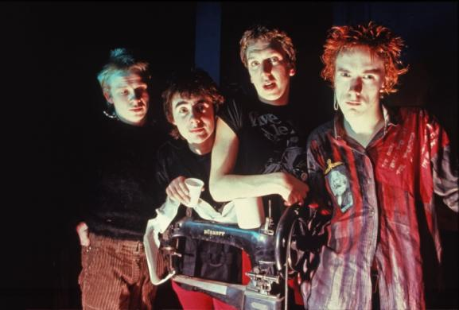
DIY music
Around 1975, a new generation of listeners was becoming increasingly unhappy with popular music. They longed for something simpler, and rejected many of the established artists and styles. They led a return to DIY (do it yourself) musical ideals. At the forefront was the British band the Sex Pistols (pictured right).
Alamy/Pictorial Press Ltd

Slide 8
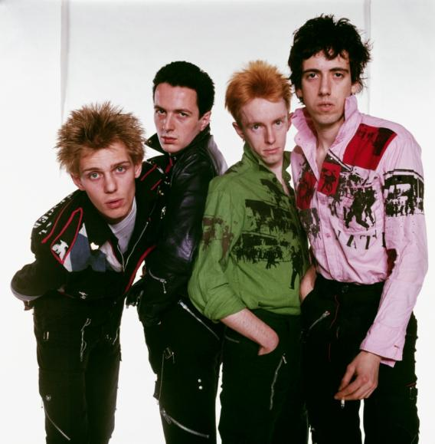
Punk
The Sex Pistols set out to deliberately shock audiences with short, sharp violent songs played at a frantic pace with full stun amplifier settings and shouted provocative lyrics. This style became known as punk music. They were joined by other bands including the Clash.
Getty Images/Hulton Archive

Slide 9
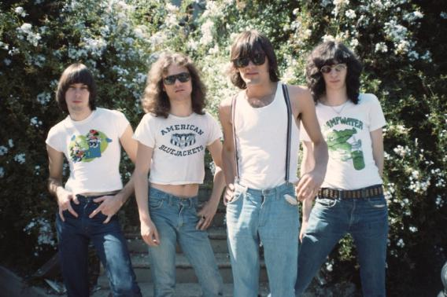
American punk
Although punk reached its peak in Britain, it really had its origins in America in the late 1960s with artists such as Lou Reed and Iggy Pop, and groups such as Television, the Patti Smith Group, and the Ramones. The Ramones (pictured right) typified the style in songs such as ‘I Wanna Be Sedated’.
Getty Images/Tom Hill/WireImage

Slide 10
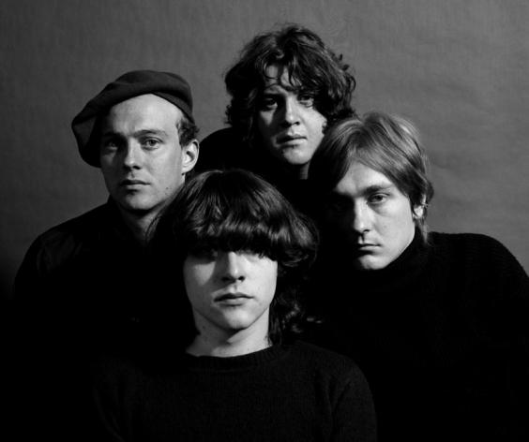
Australian punk
Australia also embraced the punk revolution. Brisbane band the Saints (pictured right) produced arguably the archetypal punk song ‘I’m Stranded’ which summed up the feelings of angst and disillusionment felt by many of the younger generation.
Corbis/Gary Ede

Slide 11
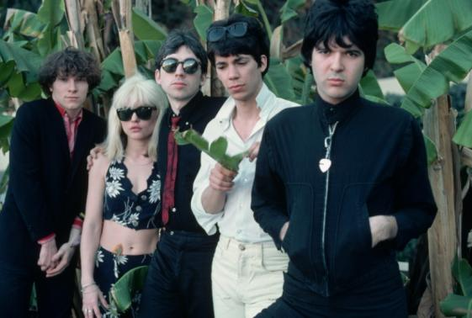
New wave
The frantic energy of punk and its hedonistic lifestyle could not be sustained, and it eventually evolved into a more polished musical style known as New Wave. Bands such as Blondie (pictured right) played short, sharp highly polished and often emotionally detached songs such as ‘Heart of Glass’.
Getty Images/Maureen Donaldson

Slide 12
Post-punk
By the early 1980s, popular music was struggling to find a new voice. Punk had burned itself out and no new definitive mainstream style had emerged to take its place. The stage was again set for a new sound.

