Slide 1
Chapters 7 and 8
Country and country rock, and progressive rock

Slide 2
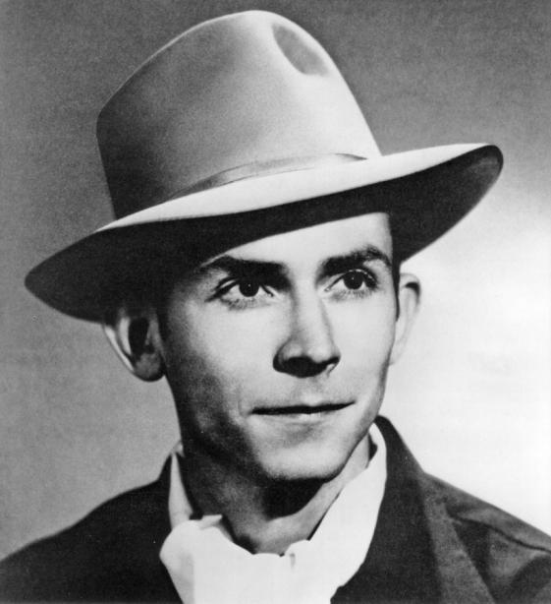
Country and Western
Country music in America evolved from European folk music. By the 1940s, it had developed its own distinctive style, called Country and Western.
Country and Western became hugely popular thanks to artists such as Hank Williams Sr (pictured right).
Alamy/Pictorial Press Ltd

Slide 3
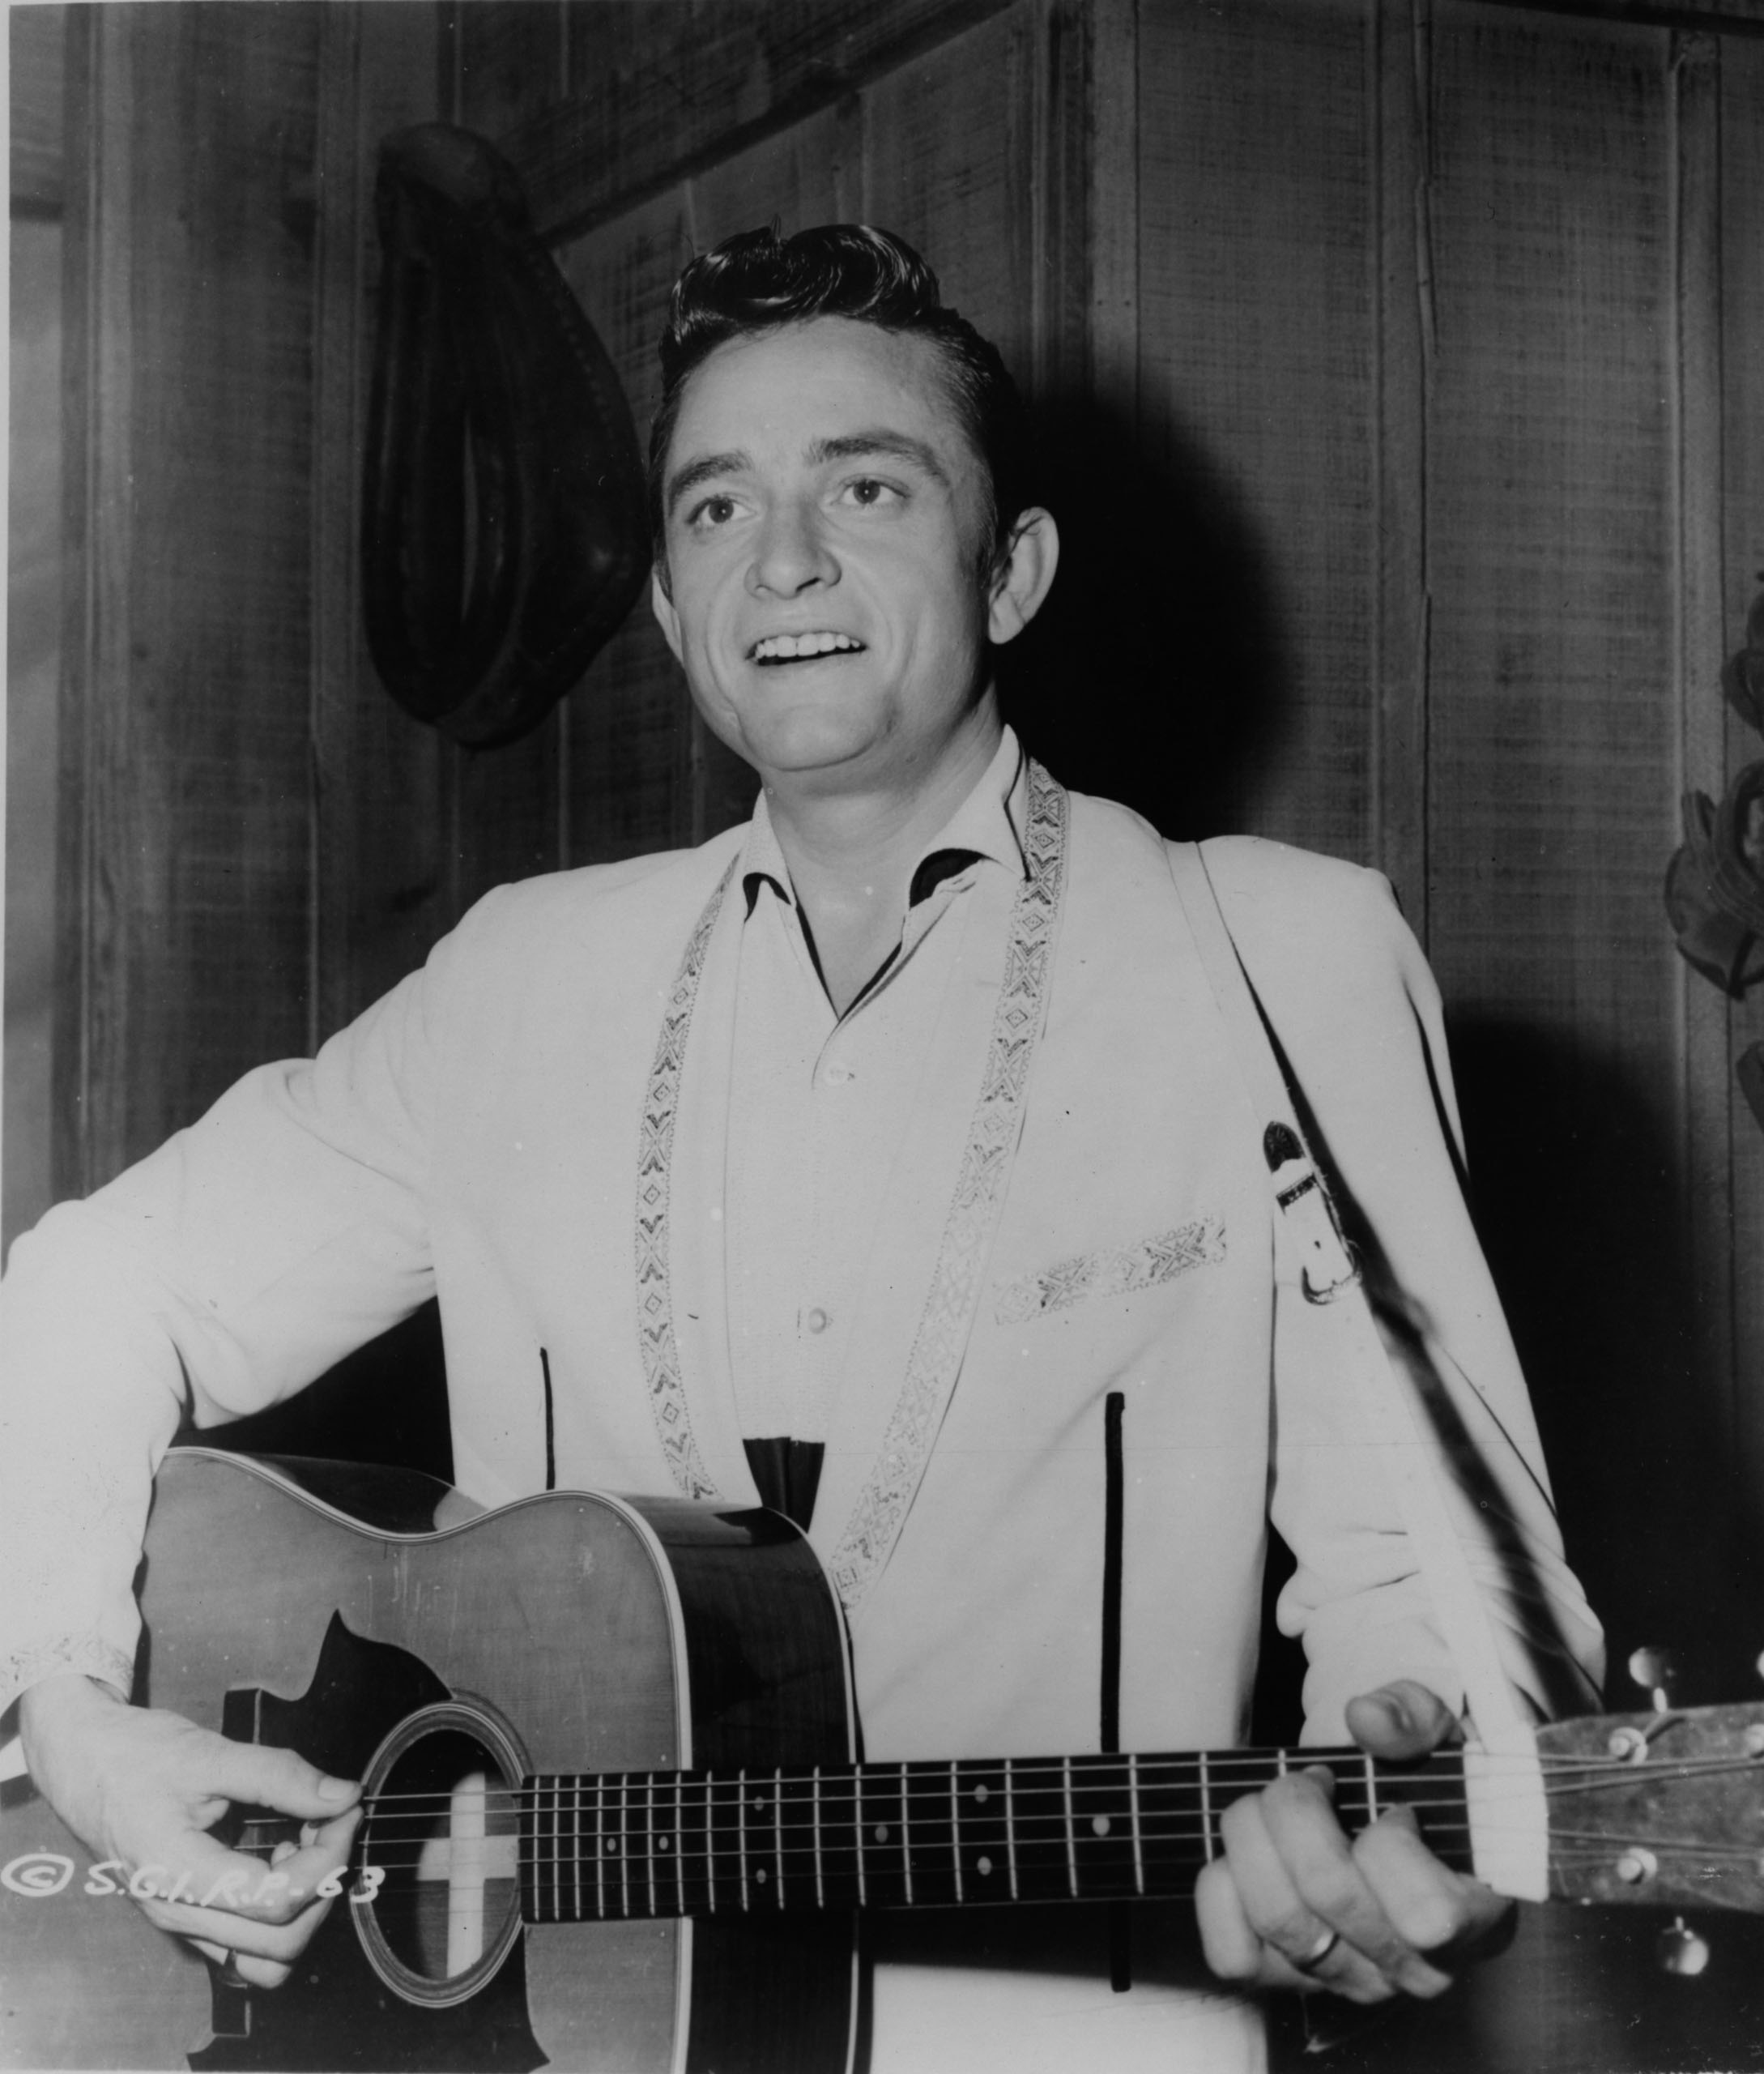
Johnny Cash
The road to country rock was pioneered by artists such as Johnny Cash (pictured right). He incorporated blues into his songs, along with a rebellious rock star image. His prison song ‘Folsom Prison Blues’ is great example of the early country rock style.
Alamy/Photos 12

Slide 4
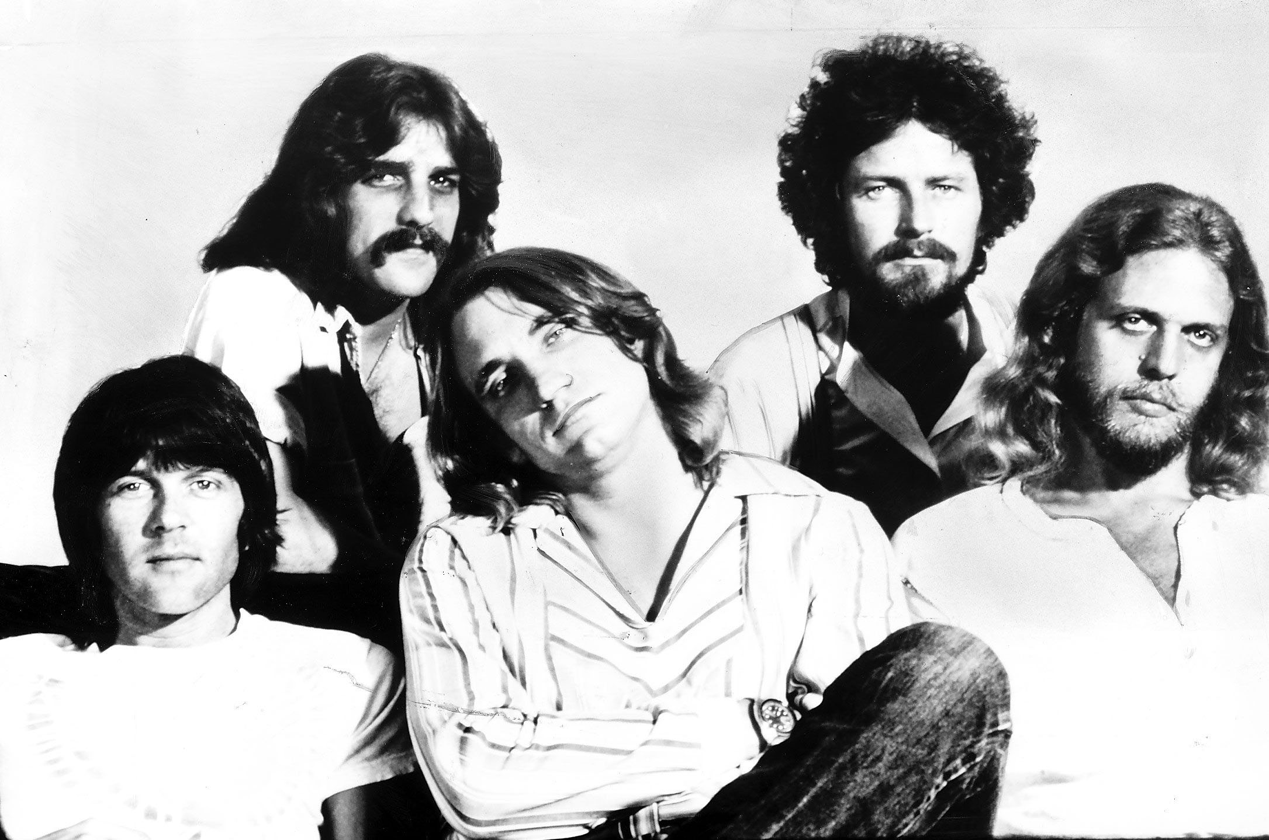
The Eagles
However, country rock was really first explored by Gram Parsons who tragically died young in 1973. His legacy was continued by arguably the greatest country rock band, the Eagles (pictured right).
Alamy/Trinity Mirror/Mirrorpix

Slide 5
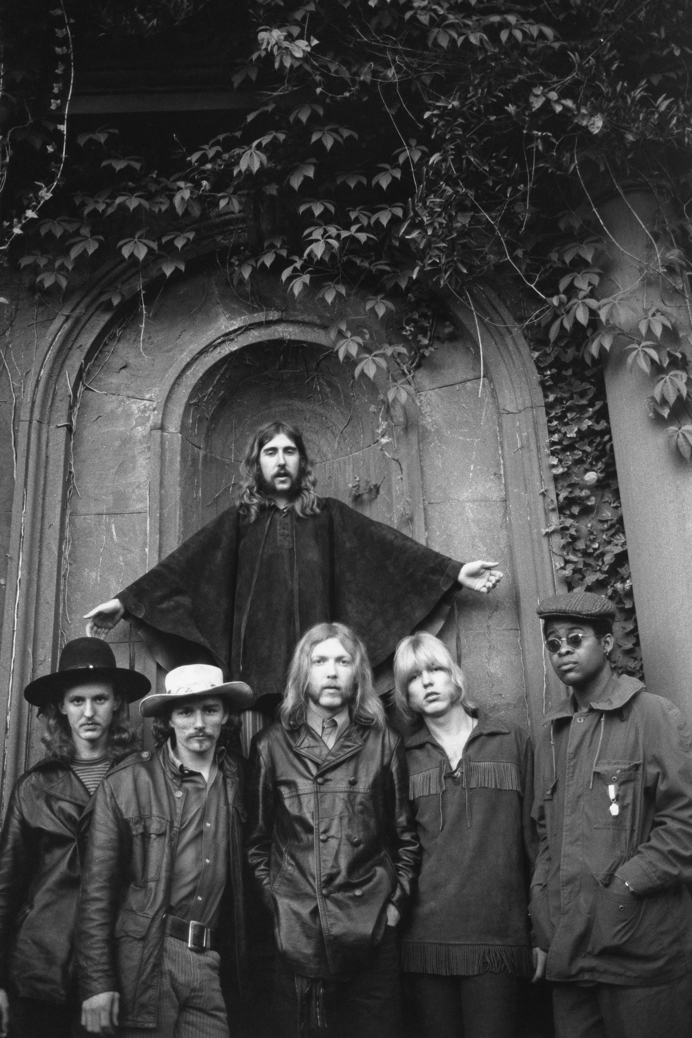
Southern rock
Eventually, a harder-edged country rock style emerged in the southern states of America. It became known as Southern rock and was personified by bands such the Allman Brothers Band (pictured right).
Getty Images/Michael Ochs Archives

Slide 6
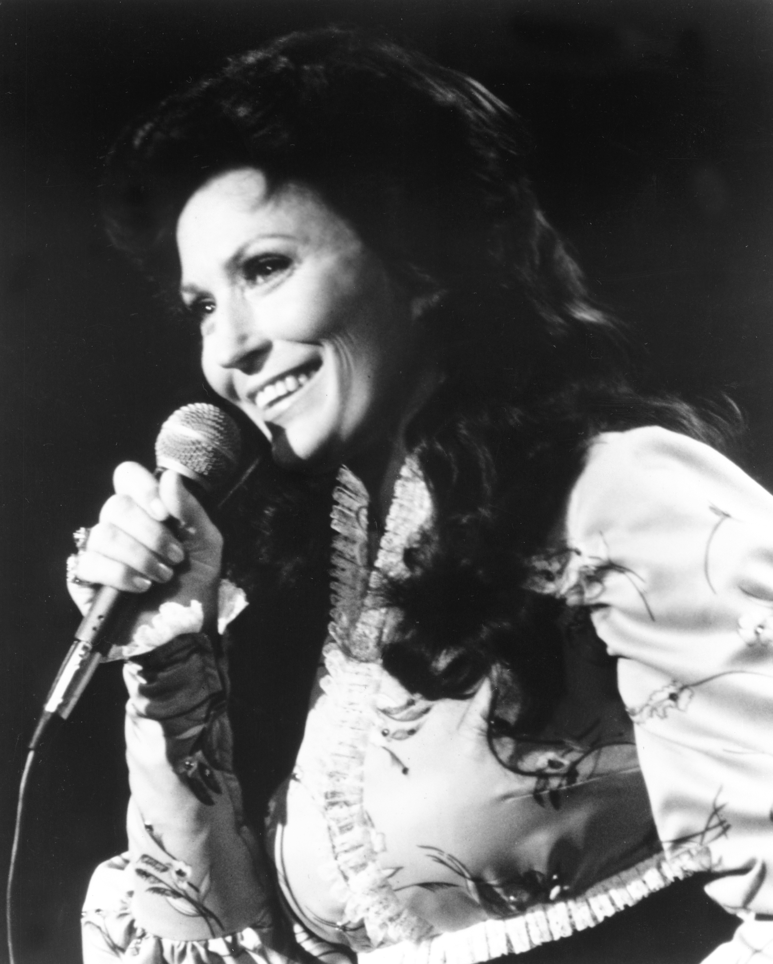
Female country artists
Female artists enjoyed a high profile in country music, including Loretta Lynn (pictured right). Her autobiographical song ‘Coal Miner’s Daughter’ became a best seller, and typified the lyrics of hardship but simple, decent values of country life.
Getty Images/Michael Ochs Archives

Slide 7

Australian country music
Australia has also enjoyed a strong country tradition thanks to artists such as Smokey Dawson and Slim Dusty. The creation of the Tamworth Country Music Festival in the early 1970s gave impetus to Australian Country Music, and helped the career of artists such as John Williamson (pictured right).
John Williamson

Slide 8
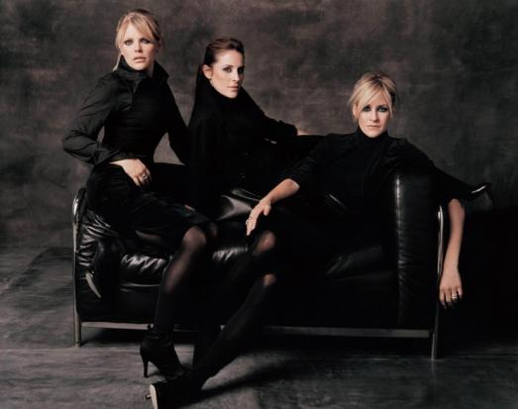
Modern country music
Country and country rock has remained a popular style in both America and Australia. Although country songs tend to avoid political messages, a storm was created in 2003 when the Dixie Chicks (picture right) criticised US President Bush for leading the invasion of Iraq.
Alamy/Photos 12

Slide 9
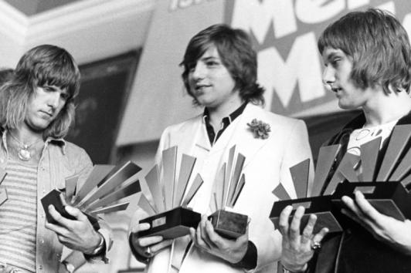
Progressive rock
Another distinctive rock style is progressive rock. Progressive rock evolved in the 1970s from the later experiments of groups such as the Beatles. Bands such as Emerson, Lake and Palmer (pictured right) created long and technically demanding songs closer to classical music.
Alamy/MARKA

Slide 10
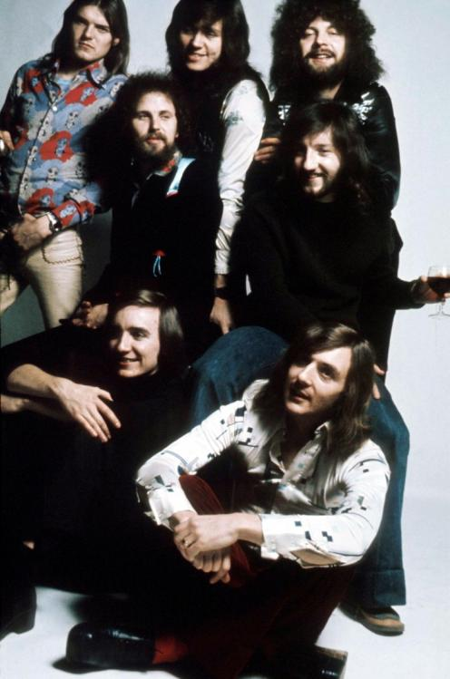
ELO
Other bands such as Electric Light Orchestra (ELO – pictured right), used orchestral instruments in their line-up.
Getty Images/Hulton Archive

Slide 11
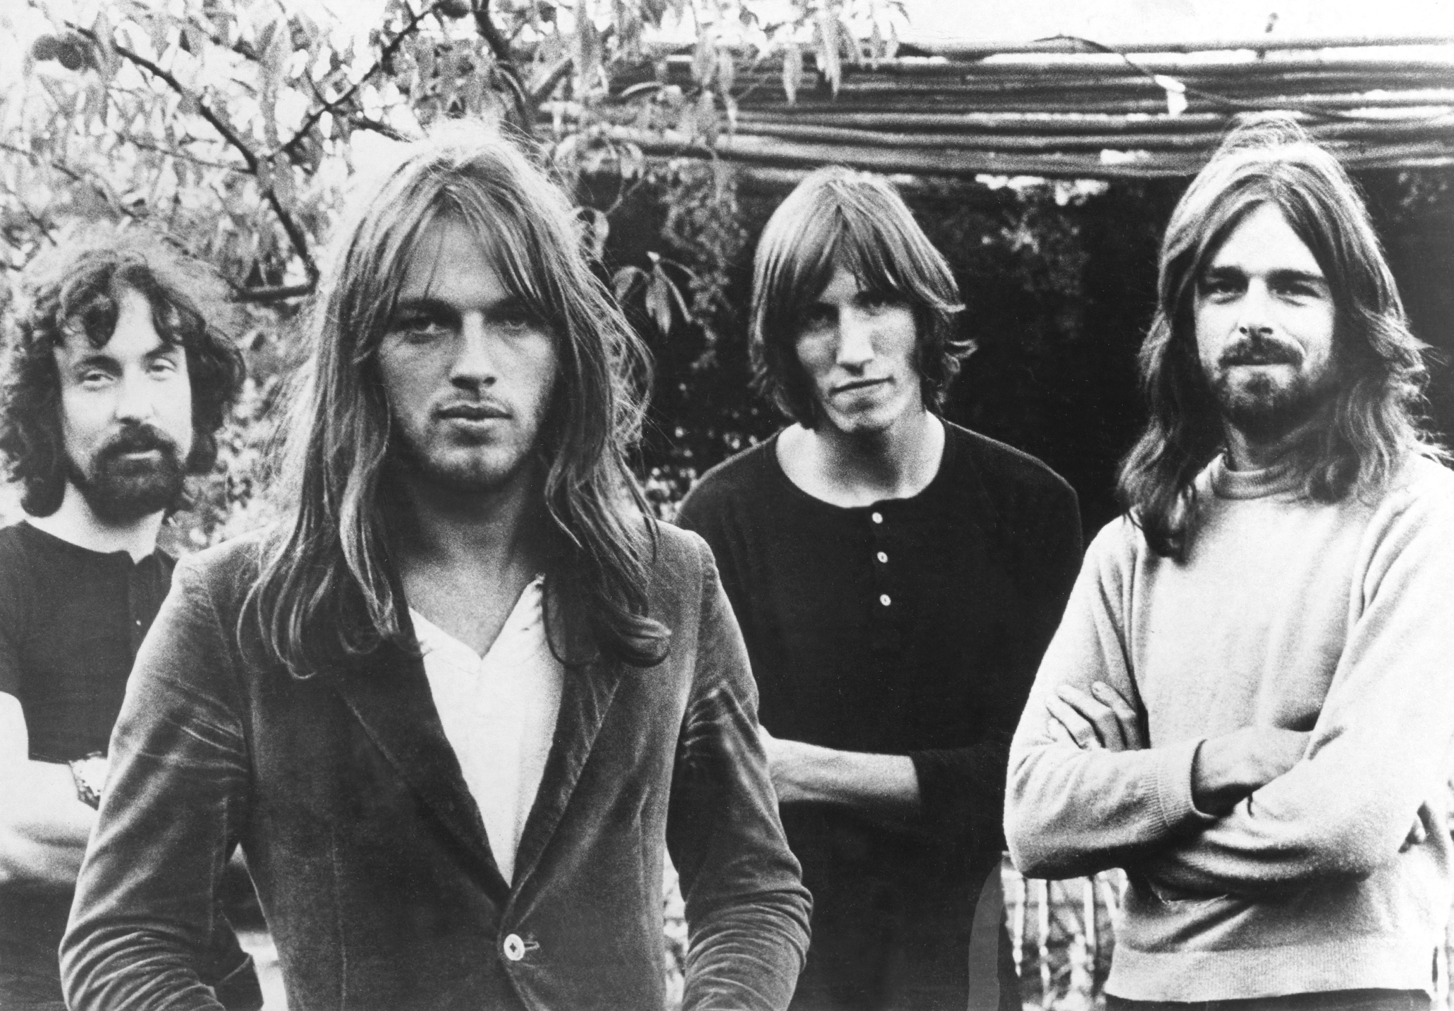
Pink Floyd
Arguably the most successful progressive rock band was Pink Floyd (picture right). Their landmark concept album ‘Dark Side of the Moon’ became one of the highest selling albums in history.
Getty Images/Michael Ochs Archives

Slide 12
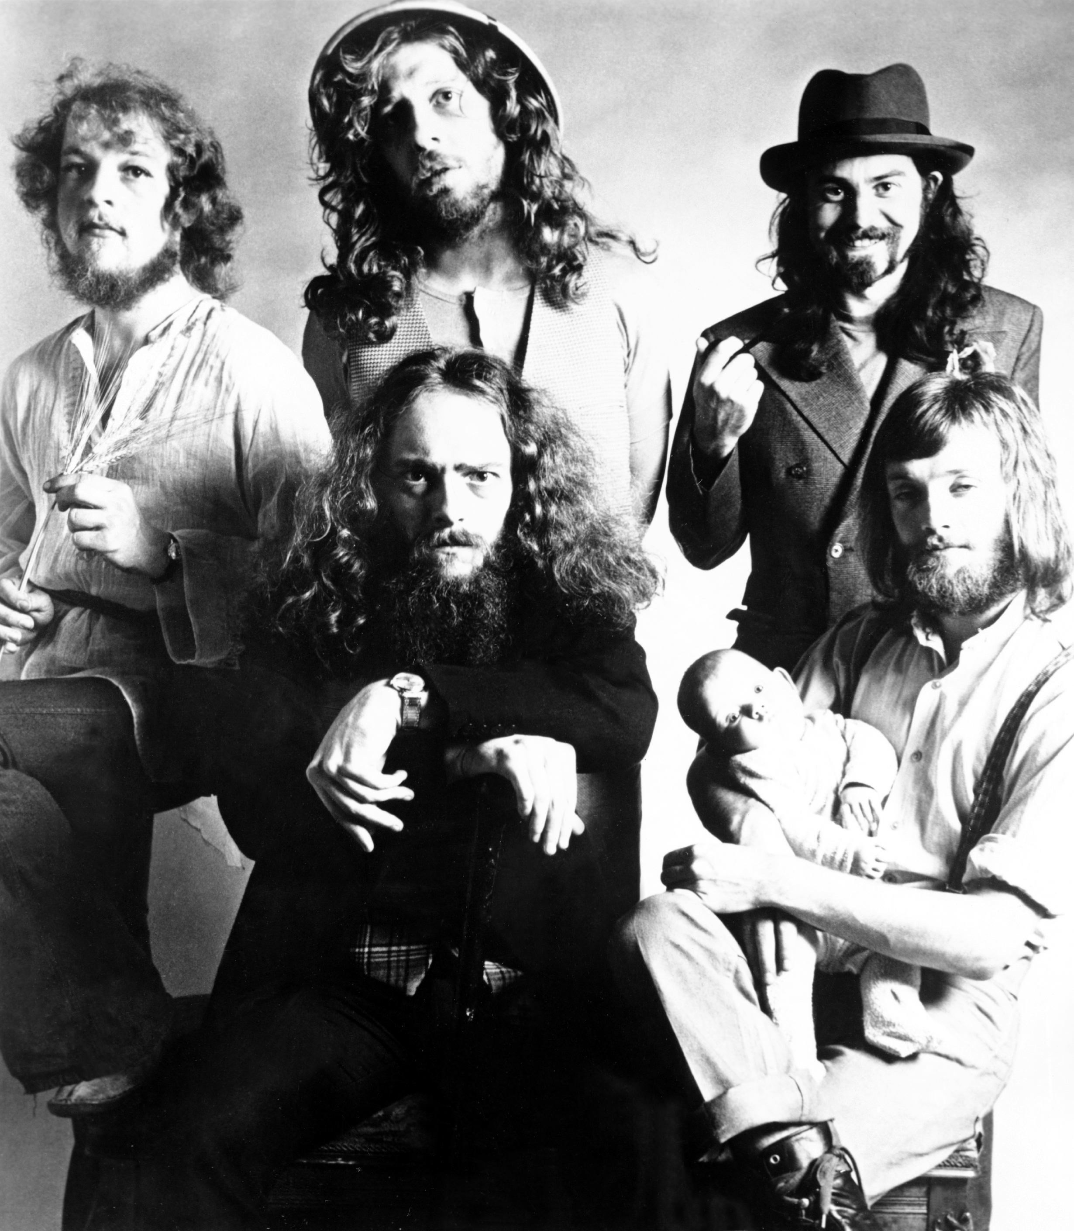
Jethro Tull
A band who combined progressive rock with folk elements was Jethro Tull (pictured right). Lead singer Ian Anderson also played the flute on many songs.
Getty Images/Michael Ochs Archives

Slide 13
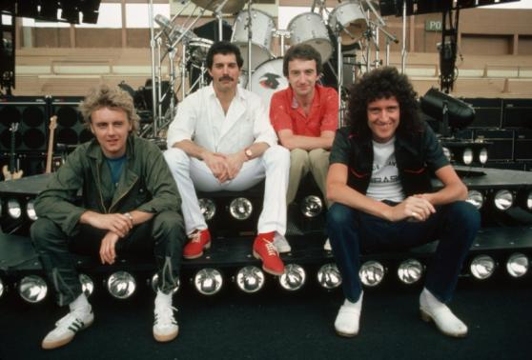
Queen
Progressive rock generally did not get much radio play because of the length of many songs, but arguably the most commercially successful progressive rock song was ‘Bohemian Rhapsody’ by Queen (pictured right).
Corbis/Neal Preston

Slide 14
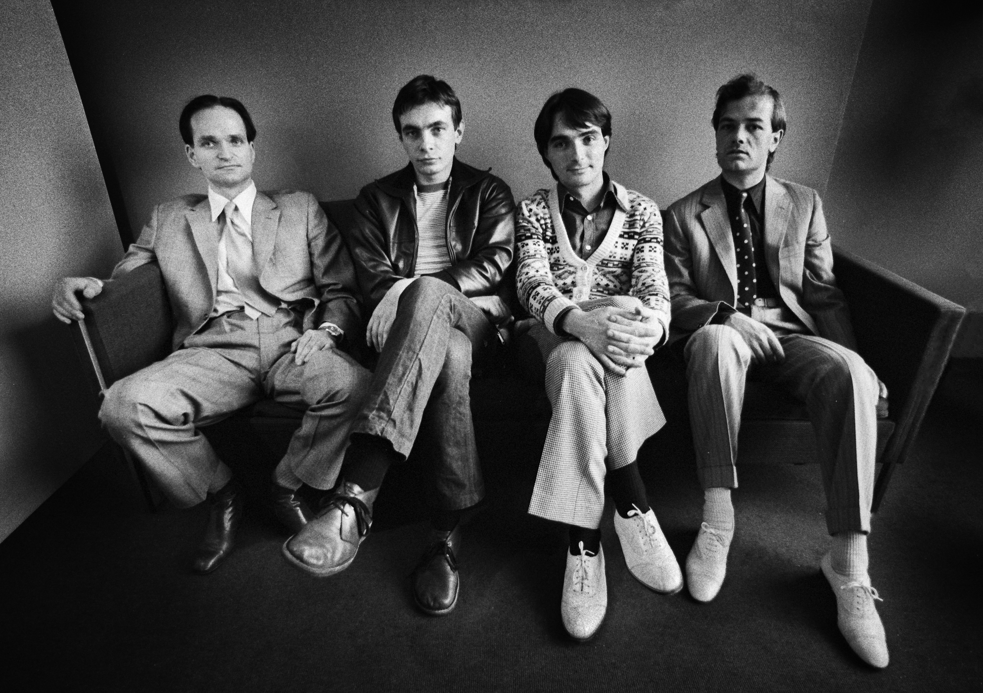
Kraftwerk
One of the first progressive rock bands to exploit the new potential of synthesisers was the German band Kraftwerk (pictured right). One of their best known albums was the Man-machine, which featured the song ‘The Robots’.
Getty Images/Redferns/Gijsbert Hanekroot

Slide 15

Australia and Prog rock
While relatively few Australian bands explored progressive rock, the style has influenced some artists including Silverchair (pictured right) in songs such as ‘Tuna in the Brine’ and ‘Luv Your Life’.
Corbis/Jared Milgrim

Slide 16
A musical revolution
Like hard rock, audiences were becoming tired of the technical displays and stadium concerts of progressive rock by the mid-1970s, and the stage was set for a musical revolution.

